Slide 1
Use of Machine Learning for Design of High-Performance Light Weight Alloys
Supervisor
Dr. Nitin Kumar Sharma
Presentation By
Viraj (B20MT050)

Slide 2
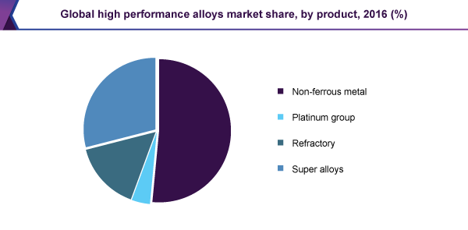
1. Problem

Slide 3
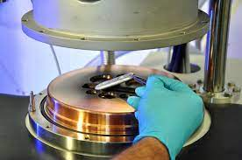
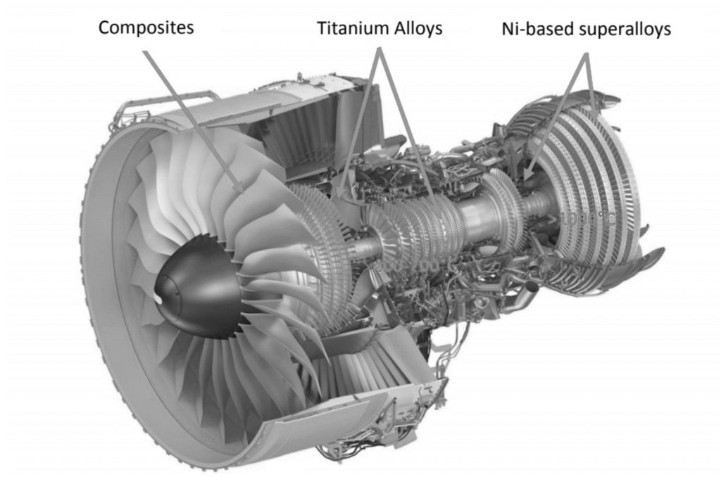
Fields in which high performance alloys are used :
Gas Turbines
Aerospace Applications
Atomic Power
Petrochemical and Industrial Chemicals
Due to increase in demands of HPAs in above fields, potential approaches need to be developed to accelerate the development of HPAs

Slide 4
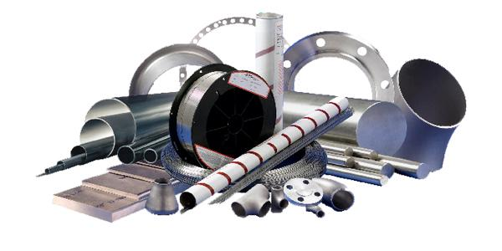
High Performance Alloys
Alloys having performance better than conventional alloys
They have following special properties:
1. High Mechanical Strength
2. Resistance to Corrosion
3. Resistance to creep
4. Resistance to oxidation
One of the example is ‘Superalloys’
Examples- Inconel, Nimonic are the series of Ni-based superalloys

Slide 5
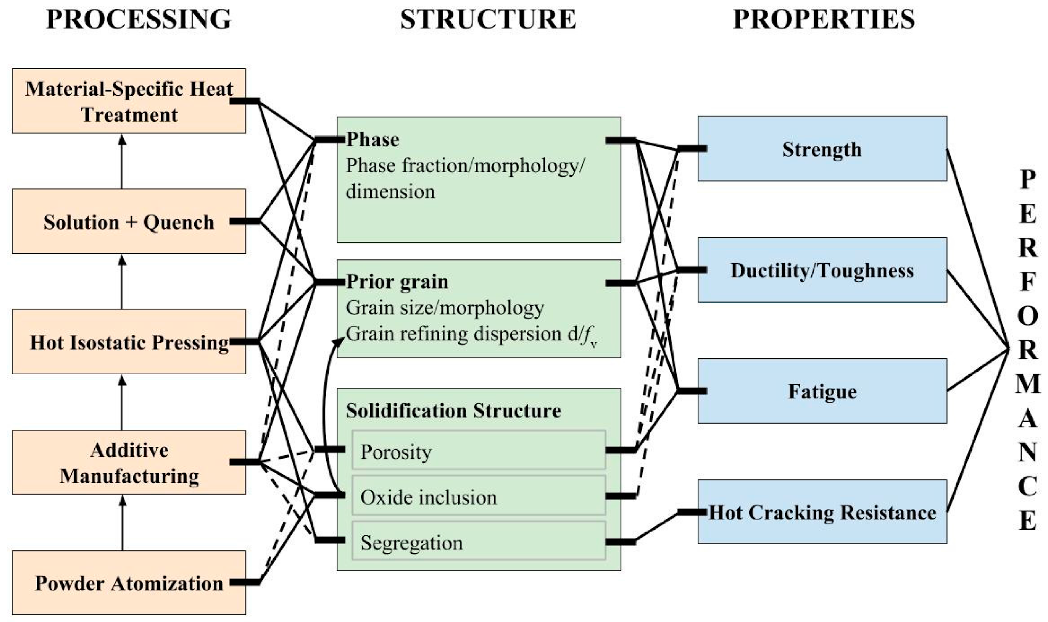
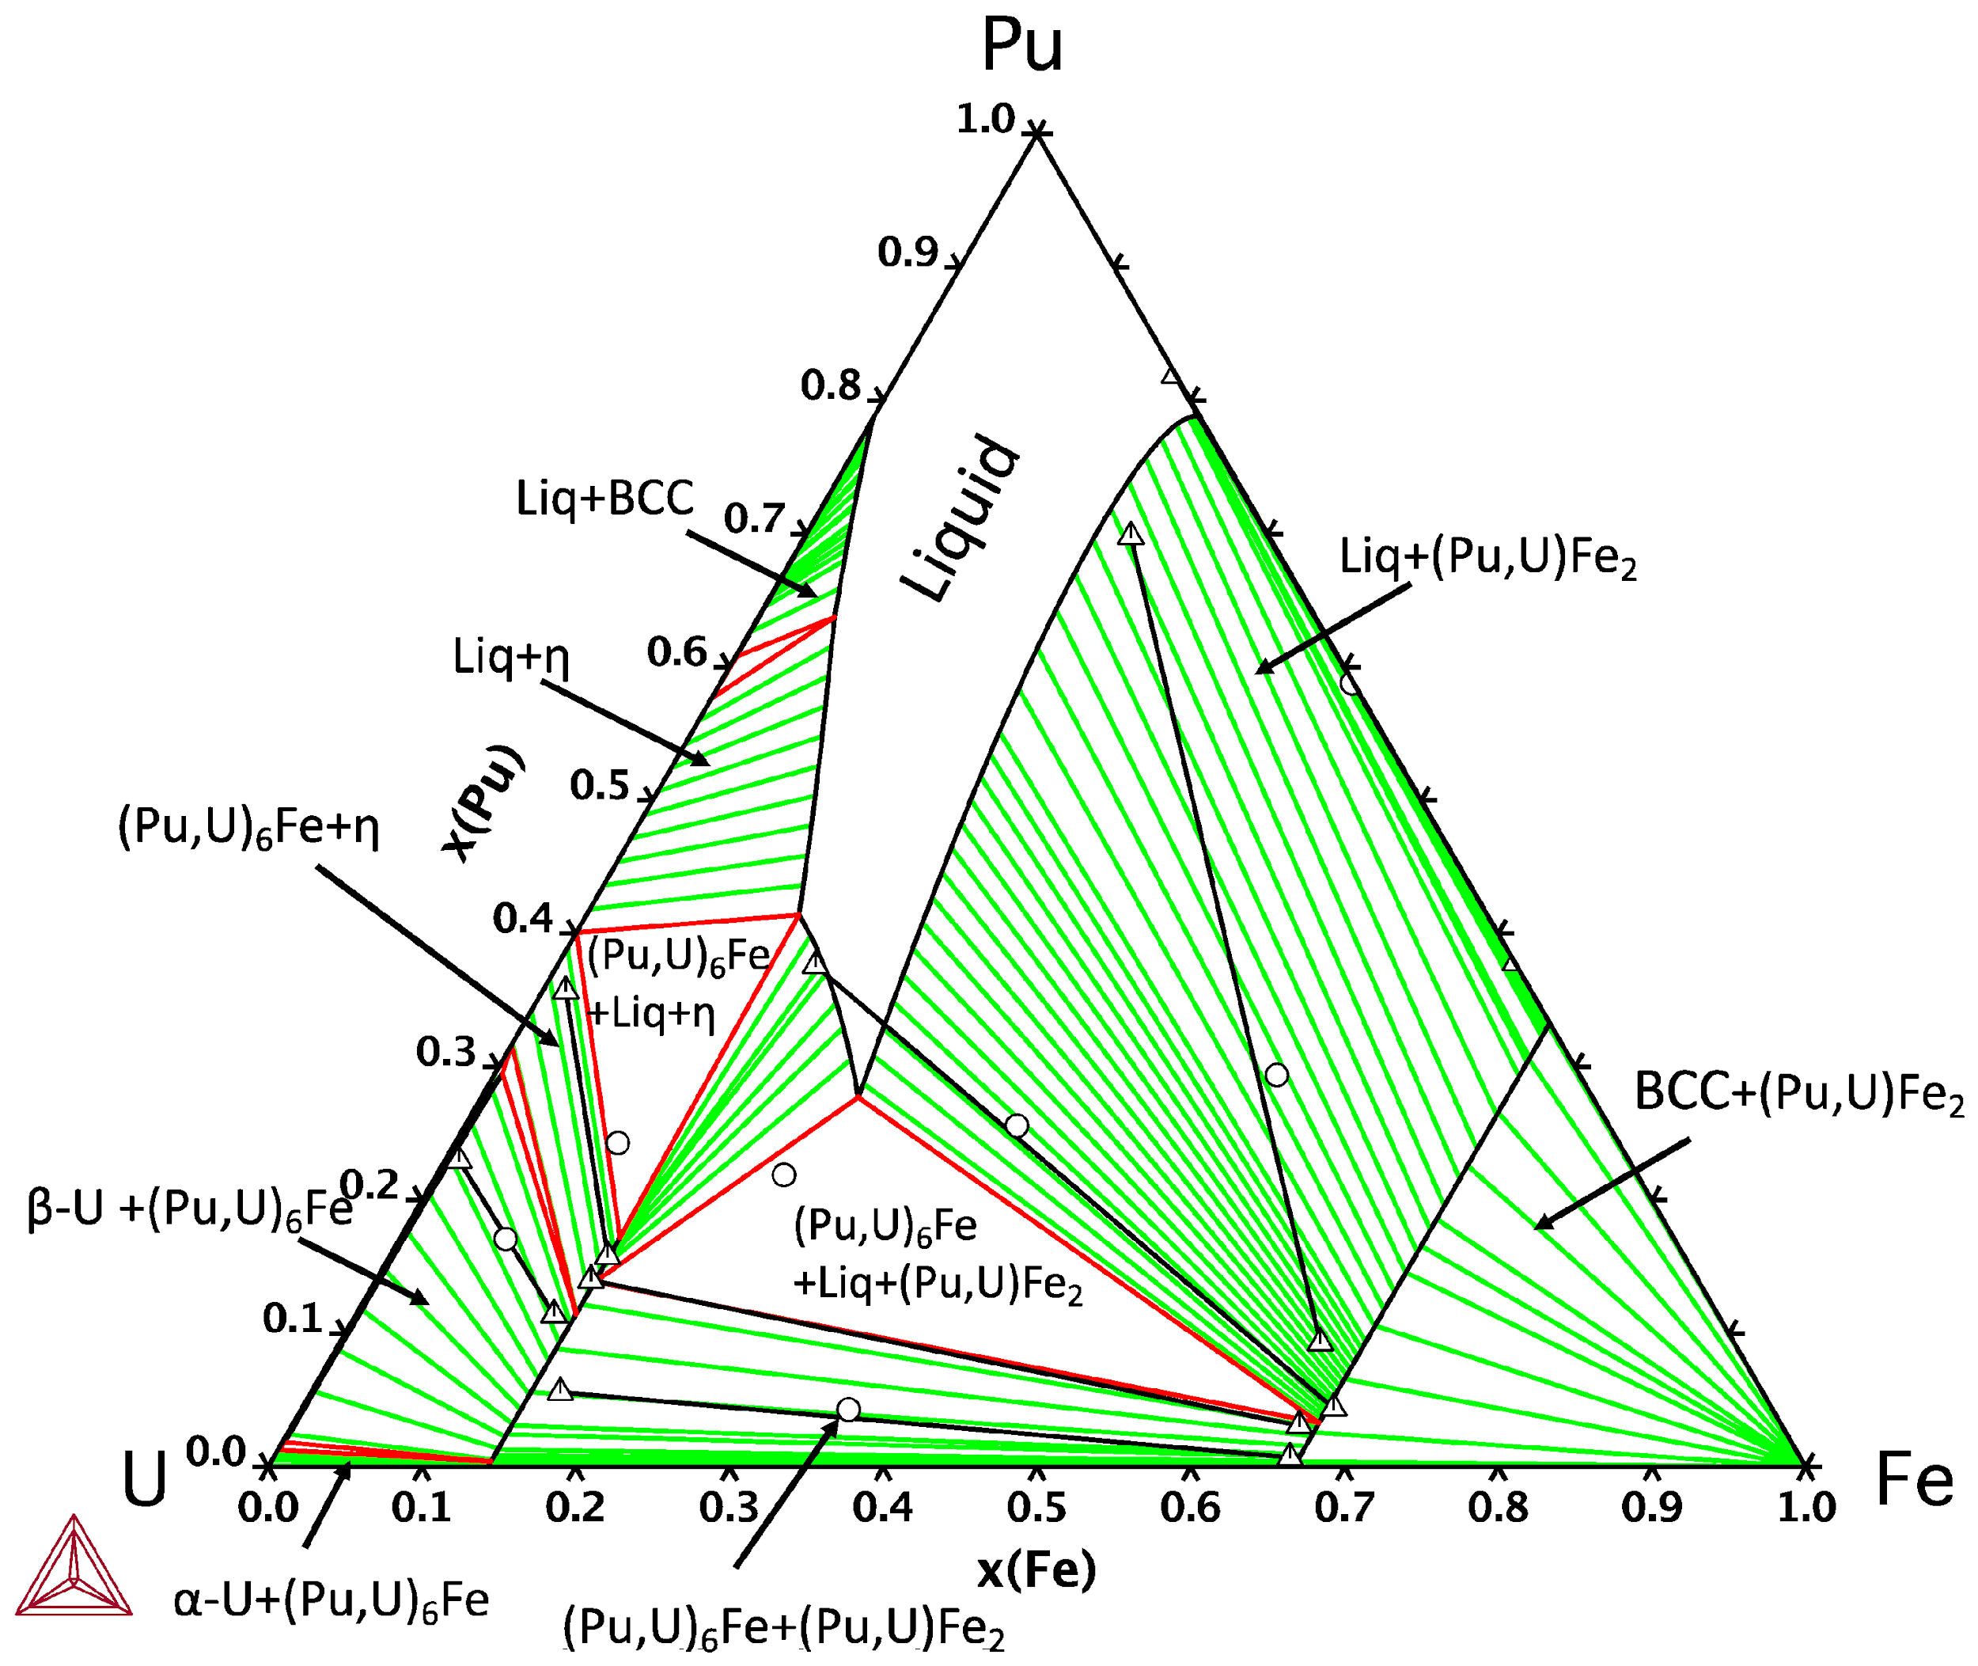
”Acceleration in Material Development Cycle"
Parametric Approach
Considers parameters such as:
Mixing Enthalpy
Difference in atomic size
Valence Electron Concentration
Failed to provide a generalized alloy design space
CALPHAD
Calculations of phase diagrams
A semi-empirical computational approach
Requires vast thermodynamic database
Impractical to search for alloy composition by experimenting with each
Drawing Phase Diagram with a greater number of components becomes difficult
Notes:
Failure reason of parametric : As their applicability to compositions outside the dataset used for formulating their empirical boundaries were unknown.

Slide 6

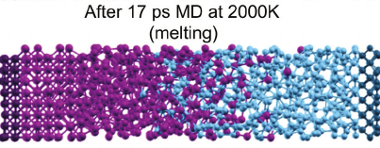
”Acceleration in Material Development Cycle"
DFT and Molecular Dynamics Simulations
Helped circumvent several limitations of the previous approaches
Limited availability of thermodynamic potentials data
Requires both high computational power and time
Machine Learning
More accurate at predicting outcomes without being explicitly programmed to do so.
Notes:
DFT : Density Functional Theory

Slide 7

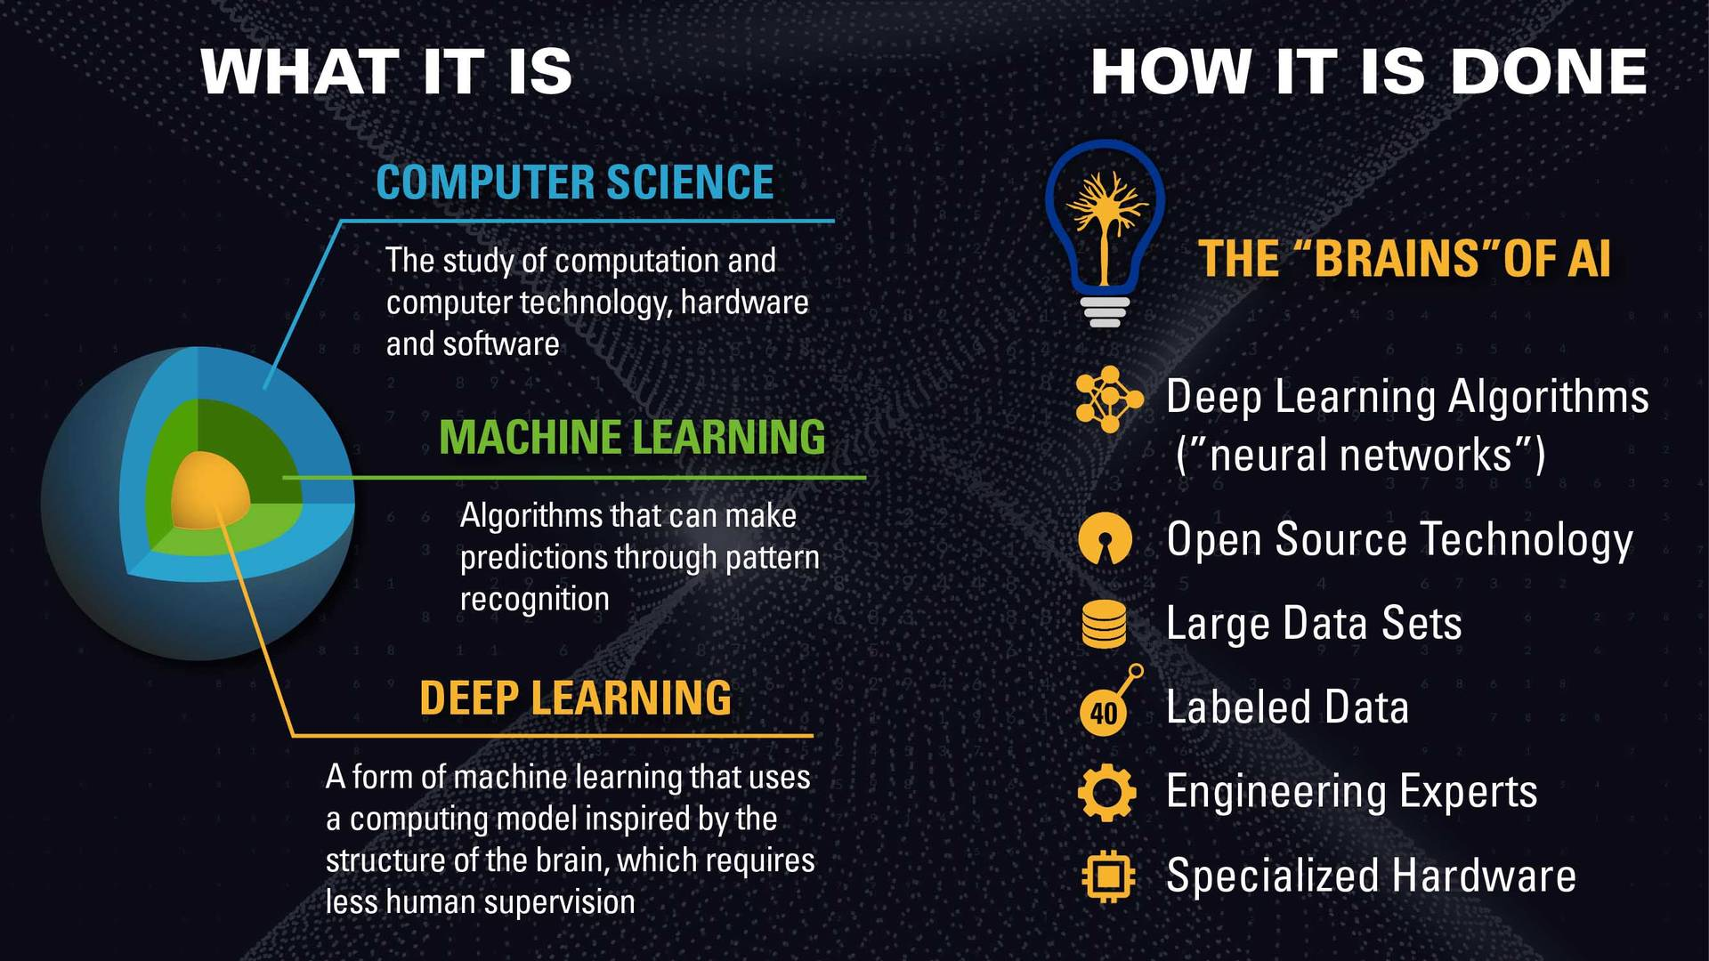

Machine Learning
Algorithms that can make predictions through pattern recognition
Algorithms used here for predicting HPAs :
Decision Tree
Logistic Regression
K-Nearest Neighbors
Support Vector Machine
All the above mentioned are supervised learning algorithms.
Notes:
Supervised Learning : machines are trained using well "labelled" training data, and on basis of that data, machines predict the output. The labelled data means some input data is already tagged with the correct output.
The aim of a supervised learning algorithm is to find a mapping function to map the input variable(x) with the output variable(y).
In the real-world, supervised learning can be used for Risk Assessment, Image classification, Fraud Detection, spam filtering, etc.

Slide 8

Decision Tree
Supervised Learning Algorithm
In the tree structure:
Internal nodes => Features of Dataset
Branches => Decision Rules
Leaf Nodes => Outcome
Decision Nodes => Used for making Decision

Slide 9

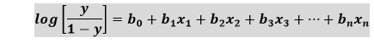
Logistic Regression
Predicts the output of a categorical dependent variable
Gives the probabilistic values which lie between 0 and 1, sigmoid function is used for this
Threshold value – defines the probability of either 0 or 1.

Slide 10
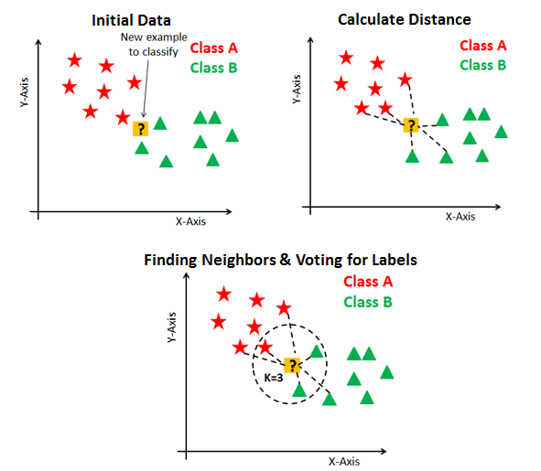
K-Nearest Neighbors (KNN)
Assumes the similarity between the new case/data and available cases and put the new case into the category that is most like the available categories.
Non-parametric and lazy learner algorithm
Notes:
Non- Parametric : does not make any assumption on underlying data.
Lazy learner : does not learn from the training set immediately instead it stores the dataset and at the time of classification, it performs an action on the dataset.
How it works :
Step-1: Select the number K of the neighbors
Step-2: Calculate the Euclidean distance of K number of neighbors
Step-3: Take the K nearest neighbors as per the calculated Euclidean distance.
Step-4: Among these k neighbors, count the number of the data points in each category.
Step-5: Assign the new data points to that category for which the number of the neighbor is maximum.

Slide 11

Support Vector Machine (SVM)
Creates the best line or decision boundary that can segregate n-dimensional space into classes.
Best Decision Boundary => Hyperplane
Chooses the extreme points/vectors that help in creating the hyperplane.
Extreme Cases => Support Vectors

Slide 12
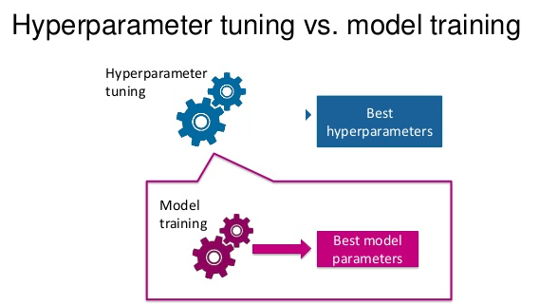
Hyperparameter Tunning
Choosing a set of optimal hyperparameters for a learning algorithm
Hyperparameter Types:
K in K-NN
Regularization constant, kernel type, and constants in SVMs
Number of layers, number of units per layer, regularization in neural network

Slide 13
Methodology

Slide 14
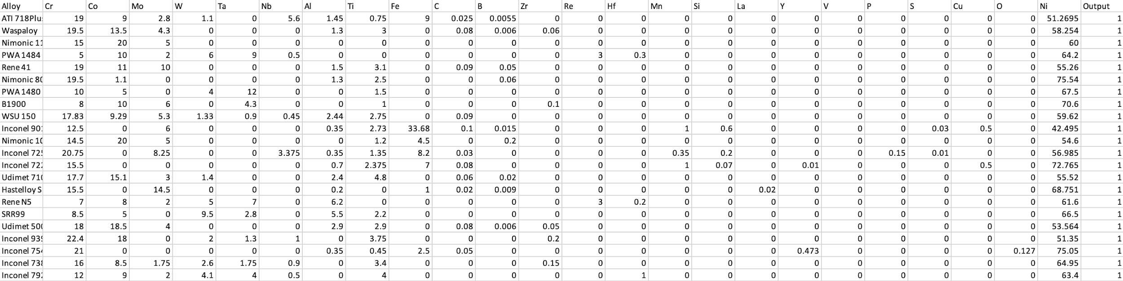
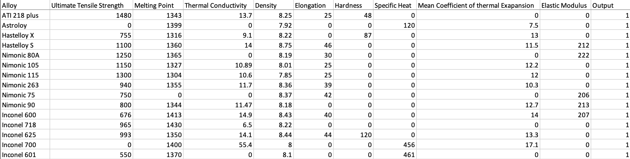
DATA

Slide 15

Methodology
Step 1
Collection of composition and properties data from available literature and research papers.
Step 2
Feeding this data to the machine learning algorithms.

Slide 16
Observation

Slide 17
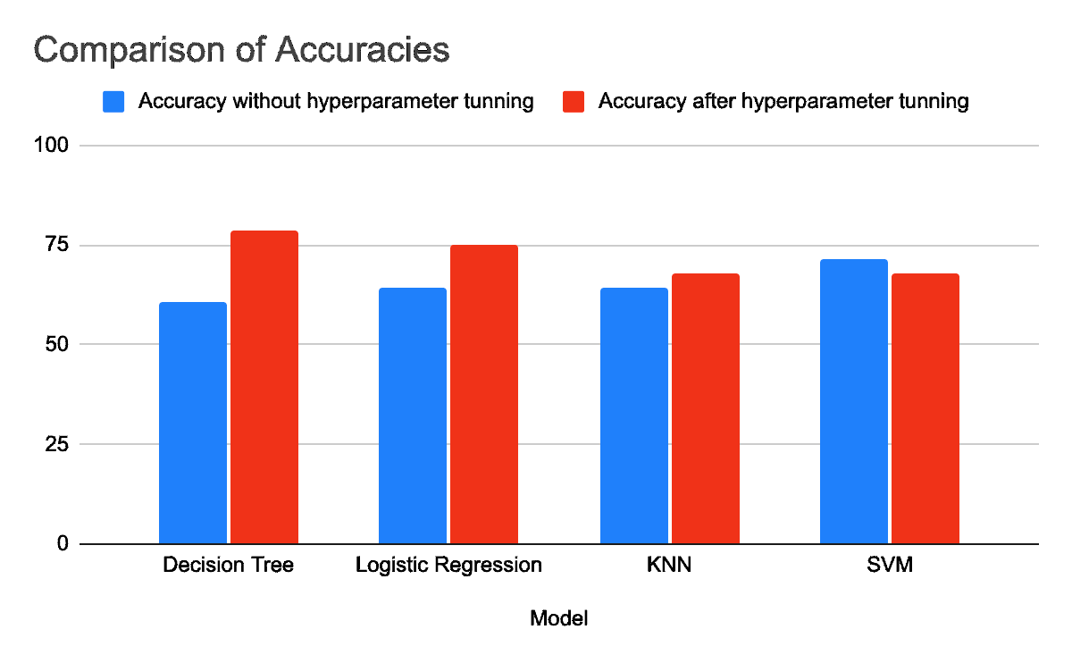
Comparing Accuracies for Composition Data
Model | Without hyperparameter tunning | After hyperparameter tunning
Decision Tree | 60.71 | 78.57
Logistic Regression | 64.29 | 75
KNN | 64.29 | 67.85
SVM | 71.43 | 67.85

Slide 18
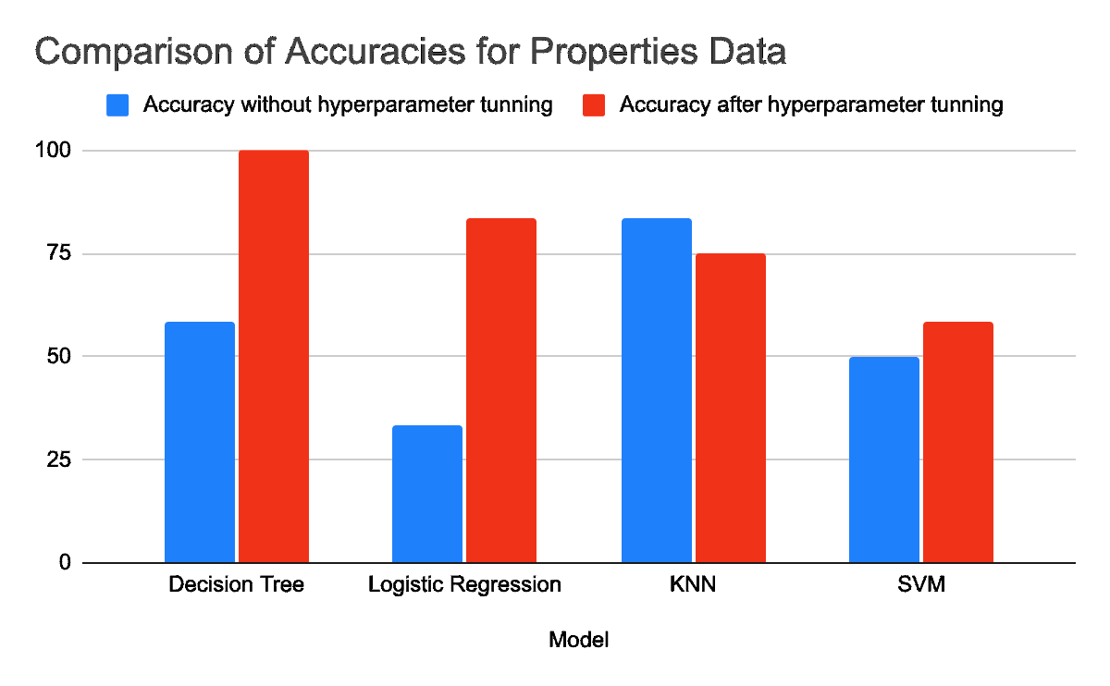
Comparing Accuracies for Properties Data
Model | Without hyperparameter tunning | After hyperparameter tunning
Decision Tree | 58.34 | 100
Logistic Regression | 33.33 | 83.34
KNN | 83.34 | 75
SVM | 50 | 58.34

Slide 19
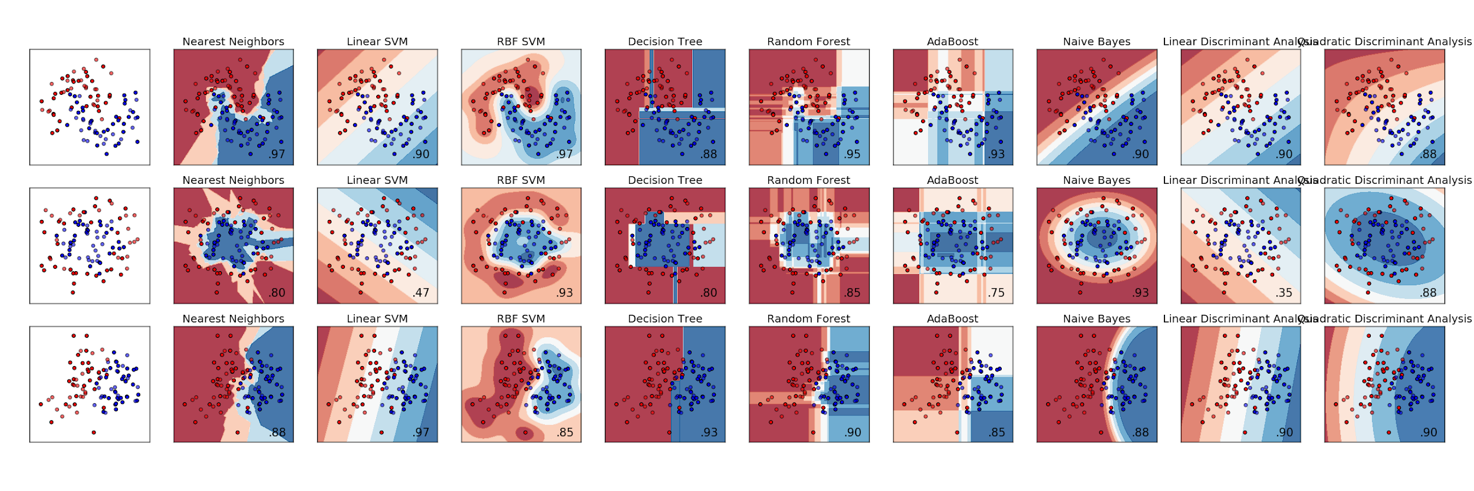
Observations
Source – scikit-learn.org

Slide 20
Conclusion

Slide 21

Conclusion
From the above observations we can conclude that:
>> Decision Tree is the best suitable algorithm for composition Data
>> Similarly, for the properties data, decision tree is the most efficient algorithm
Why a particular algorithm is better?

Slide 22
References

Slide 23
References
Akhil, B., Bajpai, A., Gurao, N. P., & Biswas, K. (2021). Designing hexagonal close packed high entropy alloys using machine learning. Modelling and Simulation in Materials Science and Engineering, 29(8), 085005.
Jaiswal, U. K., Krishna, Y. V., Rahul, M. R., & Phanikumar, G. (2021). Machine learning-enabled identification of new medium to high entropy alloys with solid solution phases. Computational Materials Science, 197, 110623.
Design and development of a high-performance Ni-based superalloy WSU 150 for additive manufacturing, by Praveen Sreeramgiri, Ajay Bhagavatam, Wayne State University, Detroit.
Carbide Formation in Nickel-Base Superalloy MAR-M247 Processed Through Scanning Laser Epitaxy (SLE), Amrita Basak and Suman Das, Georgia Institute of Technology, Atlanta.

Slide 24
References
Article on Nickel Based Superalloys by University of Cambridge
MAR M 247 DERIVATIONS - CM 247 LC DS ALLOY, K. Harris, G.L. Erickson and R.E. Schwer, Cannon-Muskegon Corporation, Michigan, USA.
Phase Diagram Calculations for Ni-Based Superalloys, N.Saunders, The University of Birmingham Edgbaston, U.K.
Bruker Alloy Tester Software
Nickel Base Materials Developments for High Temperatures, R. B. Nicholson, Royal Society of London.
Development and Turbine Engine Performance of Three Advanced Rhenium Containing Superalloys, Robert Broomfield, Malcolm Thomas, David Ford, Rolls-Royce, U.K.

Slide 25


